Slide 1
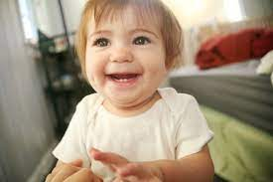
HAPPY EMOTION

Slide 2
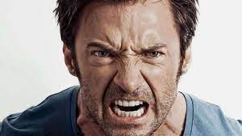
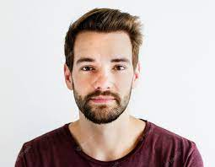
ANGRY EMOTION NORMAL PERSON

Slide 3
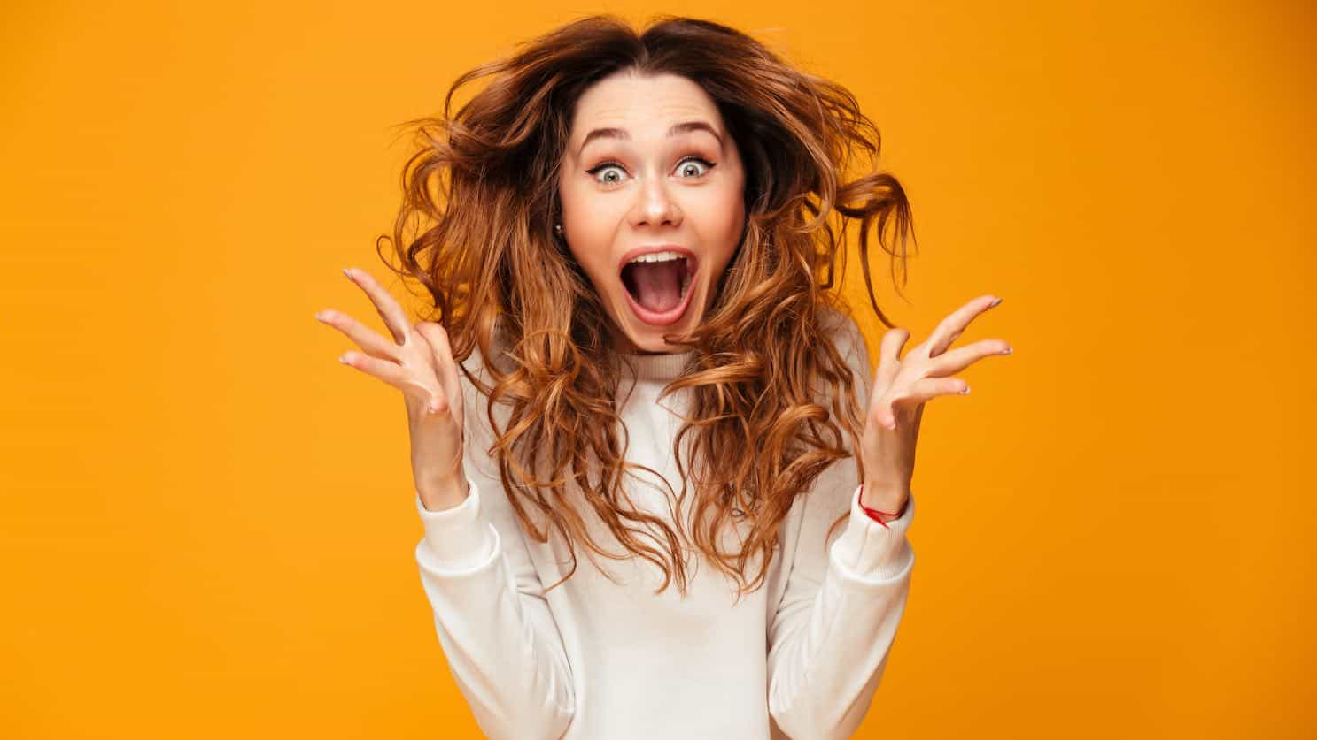
SURPRISE EMOTION

Slide 4
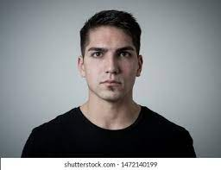
NEUTRAL EMOTION

